Slide 1

Egypt’s Global Issue Project
By Kai and Ali

Slide 2
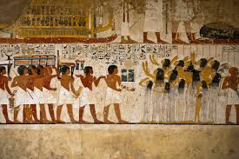
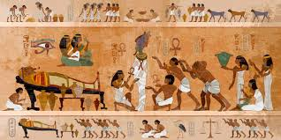
Introduction:
Location: Egypt is a country located in Africa, It borders only 3 countries Libya, Sudan and Palestine. Whilst homing 118 Million people.
Culture: Egypt has a really old culture they are a deeply rooted Islamic country. They speak many languages having spoken 6 languages over the history of Egypt, the main language as of today is Arabic.
History/Background: Egypt is one of the oldest civilizations, there is a lot of history to cover. Ancient Egypt started in 3150 BC all the way until 30BC.

Slide 3
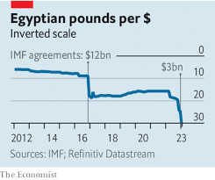
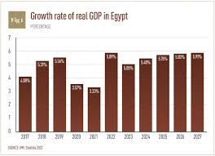
Egypt’s Economy
How is Egypt doing economically? Egypt has not been doing well in terms of their economy, they faced a lot of economic challenges over the years. Egypt also has high prices and rising debt not including the high cost of living, inflation and low wages. Whilst some of the economy is still growing their is still struggles. Due to this the living standards and situation many people struggle and barely afford to live on a day to day basis.
What steps have the government taken to help the economy? The Egyptian government has taken some actions to try to support the economy by attracting foreign investments and building big infrastructure projects. The economy has been slow when it comes to recovery and many of Egypt’s citizens have and still are feeling the effects of financial hardship and struggles.

Slide 4
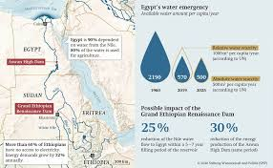
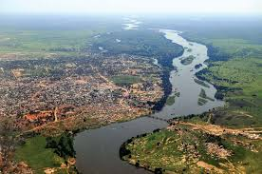
Egypts Global Issue:
Egypt has a big Global Issue which is Water Security and the Nile RIver Dispute. It is a disagreement between Egypt, Sudan and Ethiopia about how the water from the Nile can be shared amongst them.
How could this affect many countries? And Why Does It Matter?: of the Nile River gets shut down or closed, which is controlled by Ethiopia, this can affect a lot of countries for many different factors, the main ones being Farming and Safe Drinking water. The countries that could be affected by this are: Egypt, Sudan, South Sudan, Ethiopia, Uganda, Kenya, Tanzania, Rwanda, DRC (Congo), Burundi and Eritrea. These 11 countries would be the most affected by this if it occurs as these 11 countries depend on the Nile River for Water, Food Production and Electricity. It matters because this would affect million of people because of a disagreement, which could put millions of people in serious conditions considering they depends on the Nile River to run their country.

Slide 5
Egypt’s Response and Action:
How did Egypt respond to this? Egypt per hearing this problem and having this disagreement, they tried to come up with a agreement with Sudan and Ethiopian, they also responded saying the Nile River is essential for the people who depend on it and it could reduce the amount of water being supplied to the countries. Egypt used diplomacy and tried to negotiate with the countries to come to an agreement.
Did Egypt Take Any Actions? Were there any actions taken? Are they verbally or physically? Egypt tried to Negotiate with Sudan and Ethiopia, they also asked international organization like the United Nations and African Union to help intervene the dispute

Slide 6
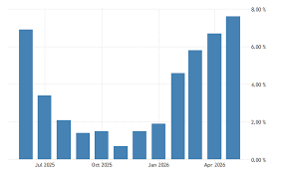
Egypt’s Consequences
What are Egypts consequences due to this.
What are Egypt’s potential consequences? If Egypt does not resolve this problem it could face many problems, they could face serious water shortages than will affect farming and drinking water a lot. If this happens Egypt’s food prices would go up and there would be economic struggles and a lower quality of life for citizens there. Since almost all Egyptians depend on the Nile River as their main source of water, etc the dispute would have a major impact on the country.

Slide 7
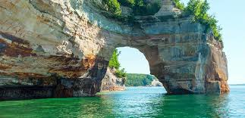
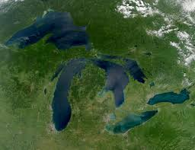
How might this compare to Canada?
Canada and Egypt can be compared in this scenario, they both have water right and security issues.
How could this compare to Canada?
Canada and the United States share a lot of rivers and lakes also including the Great Lakes. Similar to Egypt, Canada depends on the Great lakes for Drinking Water and other crucial things. If a disagreement happens between them over water usage it can and could affect millions of people from Canada and the United States. But it is not very similar to the Nile River dispute the two countries manage their water through treaties and organizations like the IJC (International Joint Commision) . This is a big reason how they prevent big conflicts between the two. It is not the same case with Egypt, it is far more serious because they rely heavily on the Nile for most of their fresh water and water that they use for growing plants, electricity etc but Canada has a lot of other freshwater sources unlike Egypt, which depends on the Nile RIver.

Slide 8
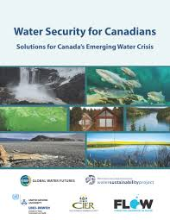
Reflection
Canadians should care about the Nile River dispute because it affects global food security, economic stability, and world affairs, If millions of people face water shortages and food shortages, it can increase poverty, migration, and conflict in the region. While a country that supports international cooperation and helping people in need. Canada has an interest in helping promote good solutions to global issues like water security which is Egypt’s biggest problem.

